Slide 1
Church Council Update

Slide 2
Church Council Membership
Keanan Foley

Slide 3
CBC grew in 2023 by…
56 new members
December 2022 – 277 members
December 2023 – 333 members
43 more weekly attendees on average.
December 2022 – 496 attendees
December 2023 – 539 attendees

Slide 4
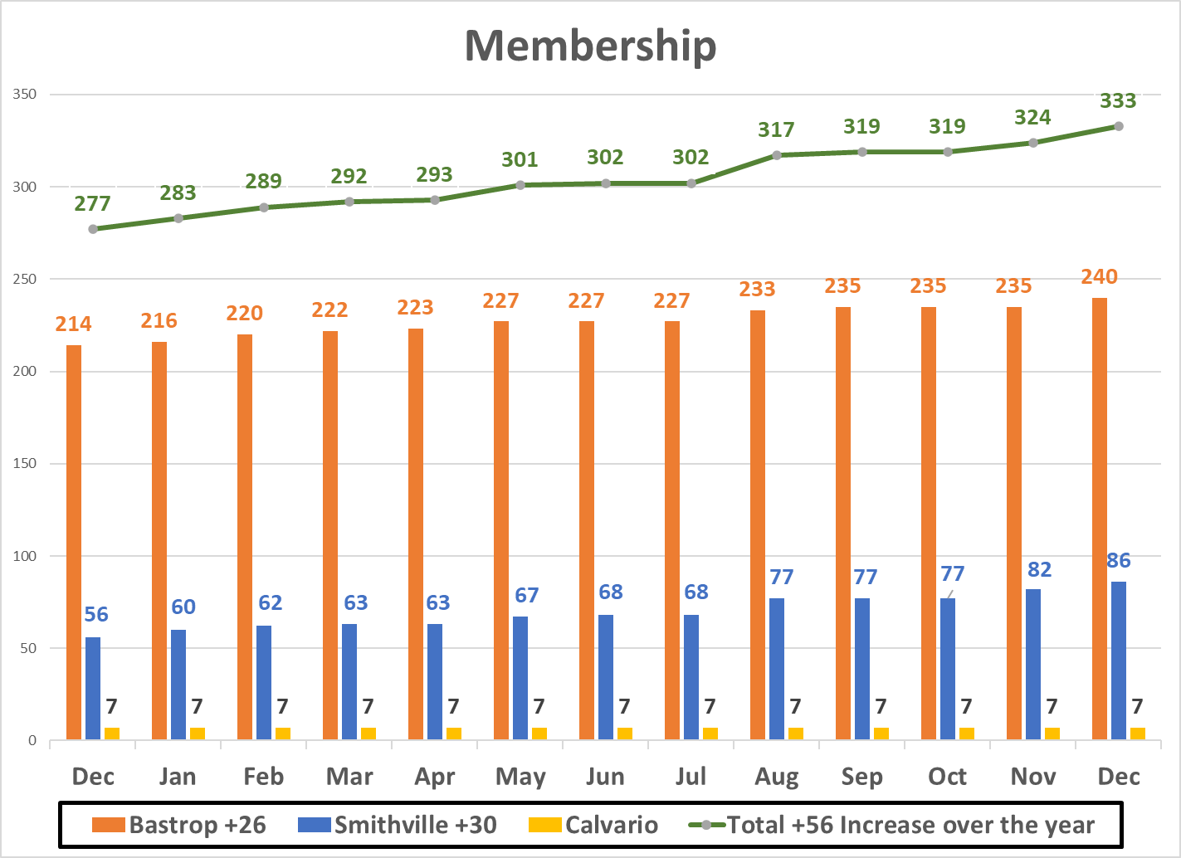

Slide 5
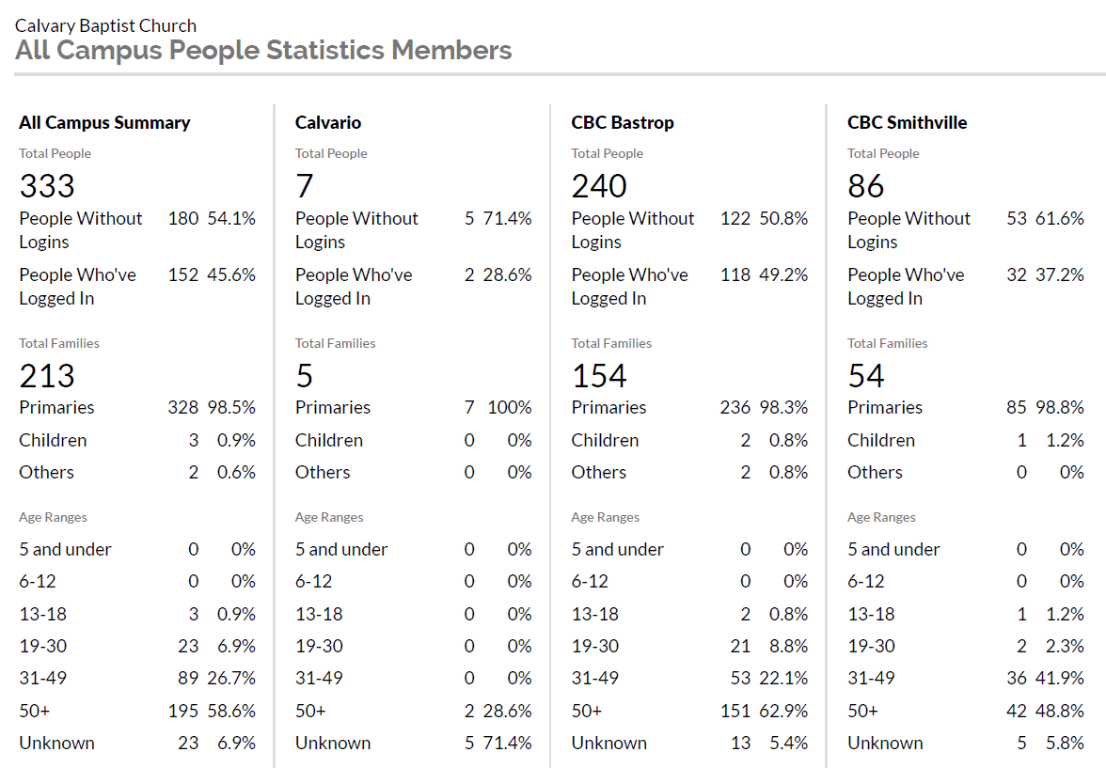

Slide 6
Council Requirements
Approximately one man for every 100 members, with intent of
representation for each campus
Church Officer requirements from Article B, Section 1 of CBC By-Laws
Active member of CBC for 12 months– regularly attending services at CBC
Actively serving in a ministry at CBC
As servants, committed to seeking God’s best for CBC
Agree with/fully support the mission, vision, and theological distinctions of CBC
While both men and women are gifted for service in the Church, the offices of Pastor and Church Council are limited to men.
Meet the requirements of leaders found in
1 Timothy 3:1-7, Titus 1:5-9, and 1 Peter 5:1-3.
Email churchcouncil@cbcfamily.net

Slide 7
What is the Council Responsible For?
The Vision for CBC
The preaching and teaching ministry at CBC
Overseeing the equipping of the CBC family for their ministries
Overseeing Pastoral Staff and Ministry Staff
Overseeing the Deacons
Ensuring transparency with other CBC leaders and the CBC family
Nominating individuals to fill Church Officer positions
Presenting church discipline issues to the CBC membership
Determining theological positions
Working with the Management Team to develop sound policies and procedures in a CBC Operations Manual
Maintaining and updating the Constitution and By-Laws
Approval of CBC membership

Slide 8
Interim Pastor Update
Ross Winton

Slide 9
Interim Pastor Update
Effective December 1, Alex Gonzales was brought on as our official interim pastor.
What is an interim?
- Resource to a church in transition to prepare them for their next pastor.
- Discerning neutral observer that can provide support & feedback.
- Encourager to staff, leaders and the church.
- Consistent preacher and teacher.
What an interim is not?
- Proving ground for a potential candidate
- Permanent staff person
- Sole decision maker

Slide 10
Interim Pastor Update
What are the interim pastor’s responsibilities?
- Provide the church a sense of stability, assessment, focus, and encouragement.
- Assist the staff, church council, other leaders, and congregation in any/all processes as needed.
- Train the pastor search team in proven processes and to point to credible resources.
- Primary preacher, but not the only preacher.
- Encourage ministerial staff to lead joyfully and effectively in alignment with church vision/mission.
- Help address any issues, if necessary, in preparation for the future pastor and his family.

Slide 11
Interim Pastor Update
What are an interim pastor’s responsibilities?
- Ensure adequate pastoral care of the staff, leadership, and congregation but not the sole provider of pastoral care.
- Work with staff, church council, and volunteers to ensure all ministries of the church are functioning.
- Coordinate with the worship leaders in planning and delivery of Sunday worship/special services at Bastrop.
- Provide evaluation of overall church health and help develop actions for correction or improvement.
- To always uphold the integrity, doctrines, values, statement of faith, constitution, and by-laws of the church.

Slide 12
Interim Pastor Update
Interim Structure within the CBC Governance?
- The Church Council will grant the interim pastor authority to accomplish the previous responsibilities.
- The interim pastor will operate under the authority of and reports to the CBC Church Council.
- The interim pastor will not have authority to hire/fire, operate outside of budget, constitution, and by-laws.
- The interim pastor will not have authority in major decision making but can offer suggestions freely. The burden of decisions belongs to the church.
- The interim pastor is not a member of any committee and will not vote at any meetings. The interim pastor can attend meetings deemed necessary or as requested.
- Currently compensating Alex out of the vacant senior pastor budget at $1250 per week including per diem.

Slide 13
Children and Student Pastors Search
Ross Winton

Slide 14
Children & Student Pastor Teams
Two teams were organized in early November to fill the current vacancies. Members had to be members of at least one year, actively serving and supporting the ministries of CBC in particular Children’s and Student ministry. Attempted to balance committee members between campuses.
Children’s Ministry Pastor Search Team:
- Nicole Garner - Michael McNabb
- Ruth McNabb
Student Ministry Pastor Search Team:
- Josh Workman - Karessa Parish
- April & Scott Holmes - Amy Wadum
- Marty Mercer
Both teams established that we were looking to fill pastoral positions.
Developed position descriptions and qualifications for the kind of candidate we are looking for.
Envisioned the direction of these two ministry areas and what they could look like going forward.
Teams will complete PST training tomorrow night and then positions will be posted.

Slide 15
Pastor Search Update
Jim Jordan

Slide 16
Current Pastor Search Team
First, many thanks to all of the past team members for their faithful service!
The current team is Jim Jordan, Keanan Foley, Jason Hoffman, Teresa Carroll and Kasey Hoffman. This brings the team to the minimum size of 5 outlined in the by-laws.
Alex Gonzales will the take the teams through additional training tomorrow night and the staff and leadership through an organization review process.
Pastor Search activity will resume tomorrow night at training.

Slide 17
A Multi-Site Strategy
Jim Jordan

Slide 18
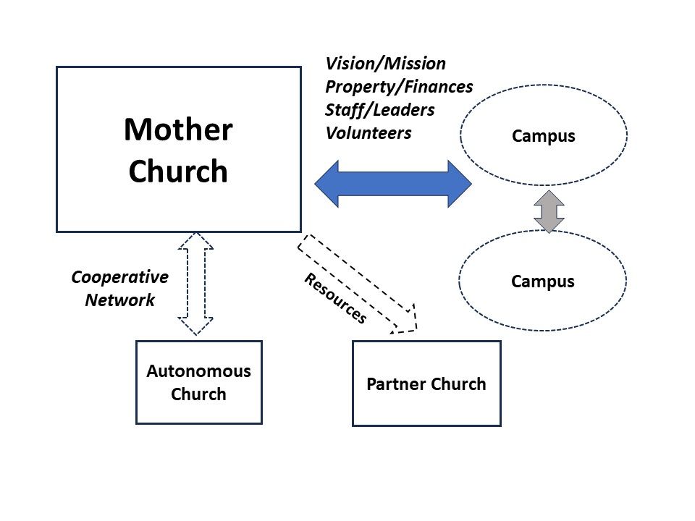
Multi-site Strategy
Why This Strategy
A common vocabulary when staring a new work.
Allows God to lead change in the future.
A clearer path for a campus to transition to independence, if led by God.
Foster healthy church growth.

Slide 19
Types of Church Relationships
Multi-site Campus
Hire a part/full time pastor.
Identify families that will attend up front.
Matrix ministry leaders to set up/run ministries.
Decide long term goal for site- campus or plant.
Revisit long term goal each year to decide what is best for reaching the local community with the gospel.

Slide 20
Types of Church Relationships
Classic Church Plant- Intentional from the start
Same steps as Multi-site but done sooner and intentionally.
Can be located further away from mother church.
Launch autonomous church in 3-5 years if possible.
Church Partnership- Assist smaller churches
Partner church is still autonomous.
Provide expertise to organize leaders/ministries.
Provide materials for sermon prep/ministries.
Open-ended support.

Slide 21
What is needed for a Campus to Become Autonomous
A Campus vote to affirm God’s leading to be autonmous
A Church-wide vote on the following:
Transition Plan- 6-12 months
Leadership identified- Local council, deacons, pastor.
Financials defined- bills, salaries, seed money, etc.
New name, tax status.
Building/Land.
Resources
Transition team from campus and mother church.
Small budget to make changes in services, etc.

Slide 22
Campus vs Autonomous
Why would a campus stay a campus?
Church remains below critical mass (can’t support staff.)
High turnover in pastors.
Why would a campus become autonomous?
Biblically based model. (Acts 14:23 / 1 Peter 5:1-3)
Flexibility and creativity in ministry and addressing those unique needs.
Reinforces each member’s responsibility for the local church.
Nurturing churches towards growth and autonomy within a network is a healthier model of planting.

Slide 23
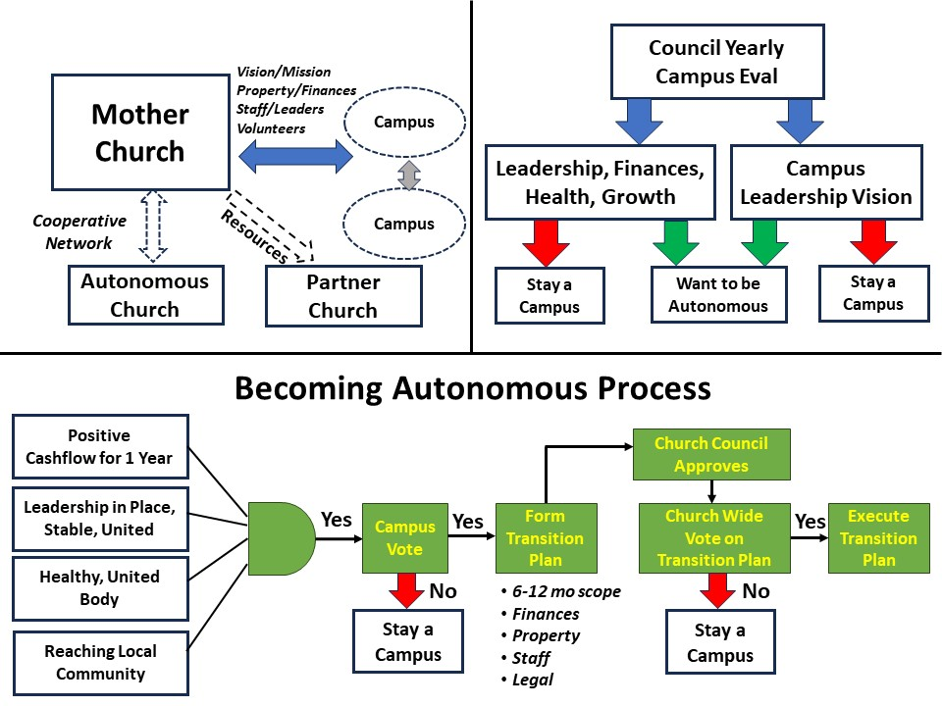
Initiation
starts with
the Campus!

